Slide 1
STAT3011 GROUP 1 PRESENTATION PENG ZHICHAO LI JINZHAO WONG KI YAN YUEN CHUN WING CHEUNG SIU FUNG WONG CHUN FAN

Slide 2
Root finding

Slide 3
Bisection method

Slide 4
Bisection method
Recall that f(x) is maximum if f’(x) = 0 and f’’(x) < 0
We can apply bisection method to find the root(s) of the equation

Slide 5
Theory

Slide 6
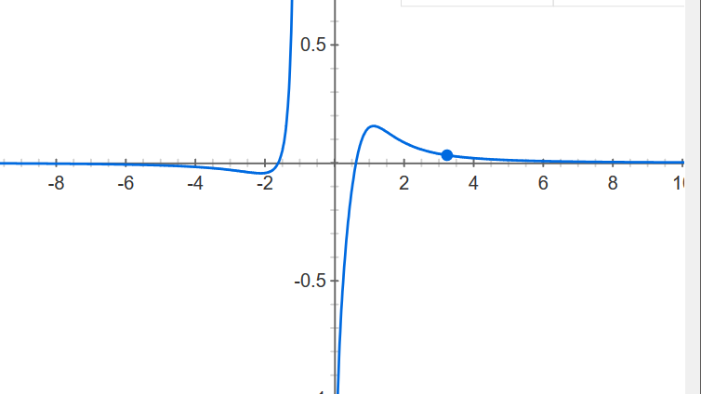
Plot of f(x)
We use the plot make an educated guess for a and b
We choose a = 0.5 and b = 1.5

Slide 7
Result

Slide 8
Newton’s method
Alternate method to find roots of f’(x) = 0
More advanced but effective method

Slide 9
Theory

Slide 10
Result

Slide 11
Comparison

Slide 12
Comparison
The problem with newton’s method is that finding f’’(x) may be complicated and time-consuming
Bisection method converges relatively slow
Bisection method is easy to implement

Slide 13
Genetic algorithm

Slide 14
Generate initial population
Selection of parents
Mutation
Crossover
Check
Next generation

Slide 15
Generate initial population
decimal : generate a series of 14 binary numbers
gfunction : convert the binary numbers into decimal numbers with 4 significant figures which range between 0 to 10
ppcode : generate a complete set of X1 to X10 as the initial population, i.e. product of X1 to X10 is larger or equals to 0.75
Population size: n = 21

Slide 16
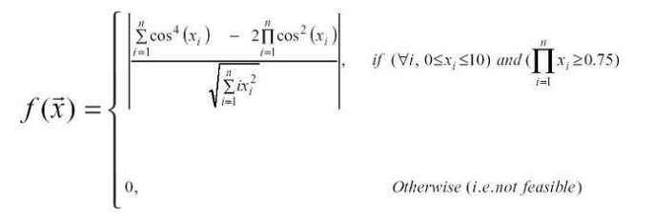
Selection of parents
fitness : calculate the value by substituting X1 to X10 into formula f(X)
rangroup : randomly divide the population into 7 groups and select the maximum within the subgroup
rangroup6 : repeat the rangroup function for 6 times in order to get 21 pairs of parents

Slide 17
Crossover
Nextgen : keep the binary digits of chromosome A (yellow) and replace the central part (the 5th to 10th digits) by chromosome B (blue)
Nextgen3 : select the parents by probability that higher the fitness, higher chance to be selected.
1st | 2nd | 3rd | 4th | 5th | 6th | 7th | 8th | 9th | 10th | 11th | 12th | 13th | 14th
1st | 2nd | 3rd | 4th | 5th | 6th | 7th | 8th | 9th | 10th | 11th | 12th | 13th | 14th
1st | 2nd | 3rd | 4th | 5th | 6th | 7th | 8th | 9th | 10th | 11th | 12th | 13th | 14th

Slide 18
Mutation
Mutation : change on the binary digits, either from 0 to 1, or from 1 to 0, this leads to the change of the value of X1 to X10
mutation rate = 0.02

Slide 19

Check
check : ensure there is no missing value within the next generation
finstep : check product of X1 to X10 of the next generation is larger than or equals to 0.75 or not; if yes, the next generation is generated, if not, a new individual will be produced by function Nextgen3

Slide 20

Next generation
GA : generate n generations by repeating the abovementioned steps to obtain the maximum
Result : return the maximum value of f(x) and the corresponding X1 to X10 after having number of iterations

Slide 21
Result
f(x) = 0.7441926
3.1636 | 0.3131
3.1227 | 0.3577
3.0025 | 0.4010
2.9128 | 0.3516
1.4649 | 0.3772

Slide 22
Integral Estimation

Slide 23
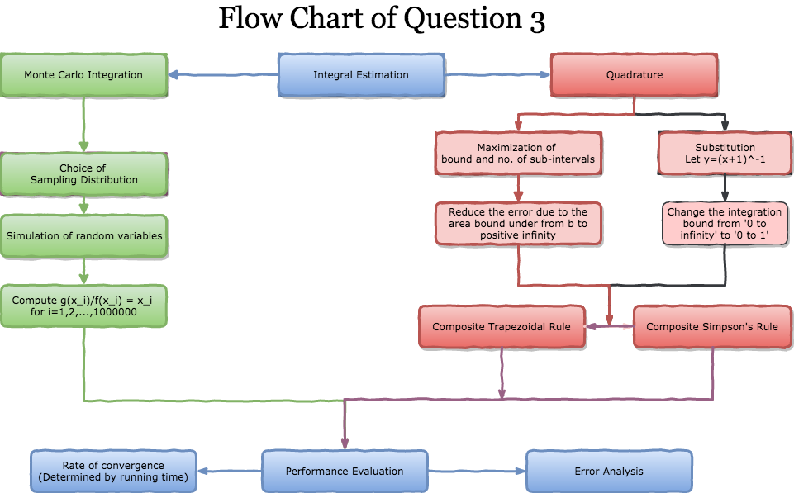

Slide 24
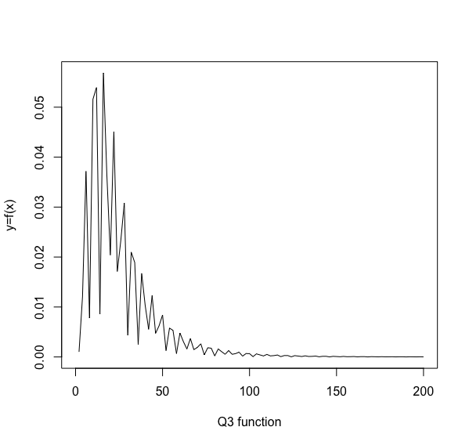
Graph Illustration of the function
Y decreases as x tends to infinity

Slide 25
Monte Carlo Integration
Big Idea Behind is the Law of Large Numbers which states that

Slide 26
Monte Carlo Integration

Slide 27
Procedure of Monte Carlo Integration

Slide 28
Error Analysis of Monte Carlo Integration

Slide 29
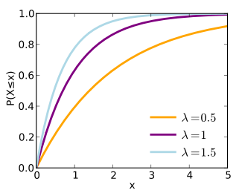
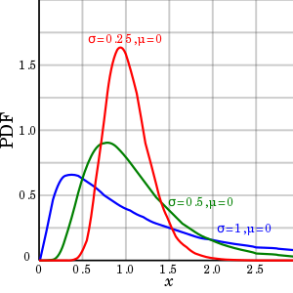

Slide 30
Transformation of the formula

Slide 31
R code – Exponential Distribution (1)
mcie <- function(n,f){ #Set up a function of simulation
U <- runif(n) # Simulate n random numbers
X <- -log((1-U)) #Simulate n values from Exp(1)
Int <- c(mean(f(X)), var(f(X))/n) #Compute g(x_i)/f(x_i)=x_1 for i = 1 to n and the error estimation
Int} #Calculate the sample mean to estimate the population mean
set.seed(77960)
mcie(5000000,f3a)

Slide 32
R code – Lognormal Distribution (3,1)
mciln <- function(n,f){ #Set up a function of simulation
X <- rlnorm(n, meanlog=3, sdlog=1) #Simulate n values from Lognormal(0,1)
Int <- c(mean(f(X)), var(f(X))/n) #Compute g(x_i)/f(x_i)=x_1 for i = 1 to n and the error estimation
Int} #Calculate the sample mean to estimate the population mean
set.seed(77960)
mciln(5000000,f3b)

Slide 33
R code
#Calculate the running time
runtime=function(fn){
start_time=Sys.time()
fn
end_time=Sys.time()
return(start_time-end_time)
}
runtime(mcie(100000,f3))
runtime(mciln(100000,f3))

Slide 34
Results
> set.seed(77960)
> mciln(5000000,f3b)
[1] 1.128507e+00 1.079433e-07
> set.seed(77960)
> mcie(5000000,f3a)
[1] 0.9318097 0.3014599
> runtime(mcie(100000,f3))
Time difference of -0.118232 secs
> runtime(mciln(100000,f3))
Time difference of -0.03117204 secs

Slide 35
Results
 | X~Exp(1) | X~Lognormal(3,1)
Integral | 0.9318097 | 1.128507
Error Estimate | 0.3014 | 1.079433*10^(-7)
Running Time(seconds) | 0.118232 | 0.03117204

Slide 36
Interesting Finding - Monte Carlo Integration
Both running time and error sampling from exponential distribution is much higher than lognormal distribution.
Error estimation decrease with N -> the Error is inversely proportional to the sample size.

Slide 37
How Did Composite Trapezoidal Rule Work?

Slide 38
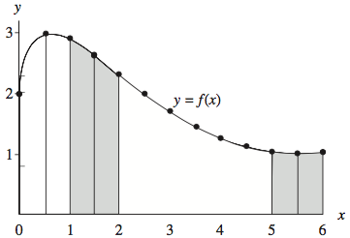
A Simple Example
b=6
a=0
h=0.5
n=12

Slide 39
How Did Composite Trapezoidal Rule Work?

Slide 40
How Did Composite Simpson’s Rule Work?
Trapezoidal Rule: Approximate the integral by subdividing the area bound by a series of trapezoids.
Simpson’s Rule attempted to improve the accuracy by using quadratic polynomials, which means that using the parabolic arcs instead of straight line segments.
Here, we use the same notation for the number of subintervals, length of each subinterval, lower bound and upper bound.

Slide 41
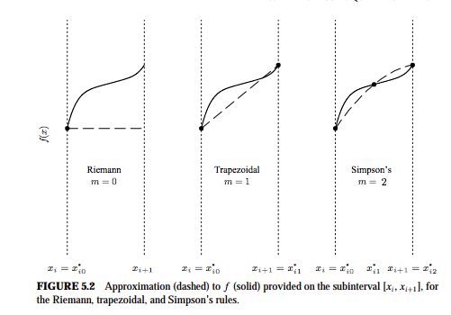
Clear Difference between the rules

Slide 42
Generalized formula of Composite Simpson’s Rule

Slide 43
Error Analysis of The Two Rules
The derivative in the formula should be mean value for integral over the entire interval
The truncation error can be reduced
by reducing the step size h and
by using the higher-order integration formula of the order of O(h²), O(h⁴), and so on. (i.e. Composite Simpson’s Rule)
For example, if the step size is reduced by half, the global truncation error of the composite trapezoidal rule is reduced by four.
Composite Trapezoidal Rules
Composite Simpson’s Rules

Slide 44
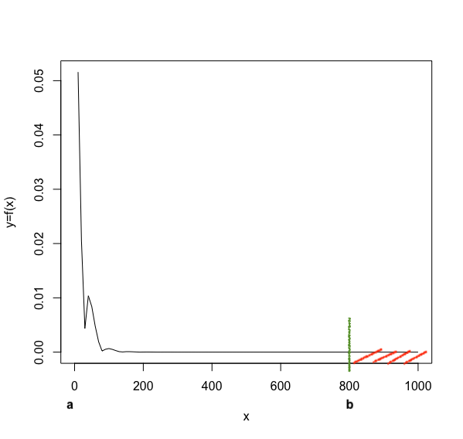
Potential Problem on Q3
The integral has singularity at x=0
R will get in the loop and fail to response if we set the upper bound to positive infinity.
The estimation may work worse on infinity bound since part of the area bound is not calculated as the figure illustrated.

Slide 45
Our Approaches
1. Compromise part of the accuracy, maximize the bound according to the performance of the computer. The error can be negligible due to the tendency to 0 as x increases.
Here we decide to calculate the integral up to 10000000 (i.e. b=1e7), subdividing the whole interval into 100000 pieces (i.e. n=1e5)
2. Transform the curve in order to change to a calculable interval by substitution.
Here we choose to substitute u equaling to 1/(x+1).

Slide 46
Our Approaches
2. Transform the curve in order to change to a calculable interval by substitution. Here we choose to substitute u equaling to 1/(x+1).
3. Add an extremely small adjustment value to the initial value x. A better approach mentioned in the reference book is transformation.

Slide 47
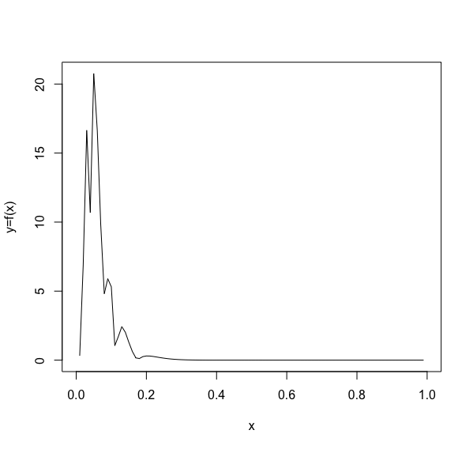
Details of Substitution

Slide 48
R Codes for the integral estimation - Substitution
#By substitution #Define the function fy=function(y){
result=(1/(y*(1-y)))*abs(cos((1-y)/y))*exp(-(log((1-y)/y)-3)^2)
return(result)
}
curve(fy,0,1, ylab = "y=f(x)") #sketch the curve in 0 to 1

Slide 49
R Codes for the integral estimation - Substitution
#1.Composite trapezoidal rule CTrape<-function(funct,a,b,n){ #Define the parameters #n is the no. of subinterval
h <- (b - a) / n #Calculate the increment
c <- 1:(n - 1) #Create a vector for the order of the increment
xj <- a + c * h #Transform the order vector to a vector of f(x_j)
Integral <- (1/2*h) * (2 * sum(funct(xj)))
#Composite Trapezoidal Rule= h/2+[f(a)+Summation_c=1_n-1(f(x_j)+f(b))]

Slide 50
R Codes for the integral estimation - Substitution
#Adjustment on the a for getting error on a = 0
value<-function (funct, x, adj=h/1e6) { #Set up an adjustment value #Compromise on a small error to avoid the infinity value on 0
if (is.nan(funct(x))) { #if condition when f(x)=NaN
if (x==0) return (funct(adj+x)) #add adjustment value to x_1 when x=0
else return (funct(adj*(-1)+x)) #prevent any NaN cases of x_j!=0
}
else {return(funct(x))}
}

Slide 51
R Codes for the integral estimation - Substitution
Integral=Integral+(h/2*(value(funct,a)+value(funct,b))) #Calculate the final Integral
(Result= Integral)
}
set.seed(77960)
CTrape(fy,0,1,2000)

Slide 52
R Codes for the integral estimation - Substitution
#2. Composite Simpson's rule
CSimp<-function(funct,a,b,n) { #Define the parameters #n is the no. of subinterval
h <- (b - a) / n #Calculate the increment
c<-0:(n-1)
d <- 1:(n - 1) #Create a vector for the order of the increment
xj1 <- a+(c+1/2)*h #Transform the order vector to a vector of f(x_j)
xj2<- a+(d*h)
Integral <- (1/6*h) * (4 * sum(funct(xj1))+2*sum(funct(xj2)))
#Calculate parts of the formula of Simpson's rule

Slide 53
R Codes for the integral estimation - Substitution
#Adjustment on the a for getting error on a = 0
value <- function (funct, x, adj=h/1000000) {
#Set up an adjustment value #Compromise on a small error to avoid the infinity value on 0
if (is.nan(funct(x))) {
if (x==0) return (funct(adj+x))
else return (funct(adj*(-1)+x))
}
else {return(funct(x))}
}

Slide 54
R Codes for the integral estimation - Substitution
Integrand=Integral+(h/6*(value(funct,a)+value(funct,b)))
#Composite Simpson's Rule= h/6*[f(a)+4*Summation_i=0_n-1(f(a+(i+1/2)*h))+2*Summation_i=1_n-1(f(a+i*h)+f(b)]
(Result= Integral) #return the result
}
set.seed(77960)
CSimp(fy,0,1,2000)

Slide 55
Matlab code for the error estimation - Substitution
syms x %create symbolic variable x
tic %start stop watch timer
equation=(abs(cos((1-x)/x))/x/(1-x))*exp(-(log((1/x)/x)-3)^2);
d4equation=diff(equation,4); %obtain the fourth derivative of the equation
a=0;b=0; %initialize the variables
for n=0.0005:0.25:1 %define the interval and the increment
a=a+subs(d4equation,x,n); %for loop for the sum of the derivatives at points
b=b+1; %order increases by 1 after sum of a
end
average1=a/b; %calculate the mean of the derivatives
cserr=average1.*(1/2880).*(1e7-1/1e7).^5./1e5.^4 %Error estimation of CsimpsonRule
toc %stop the stop watch timer and show the elapsed time

Slide 56
Matlab code for the error estimation - Substitution
tic %start stop watch timer
equation=(abs(cos((1-x)/x))/x/(1-x))*exp(-(log((1/x)/x)-3)^2);
d4equation2=diff(equation2,2); %obtain the second derivative of the equation
c=0;d=0; %initialize the variables
for n=0.0005:0.25:1 %define the interval and the increment
c=c+subs(d4equation2,x,n); %for loop for the sum of the derivatives at points
d=d+1; %order increases by 1 after sum of c
end
average2=c/d; %calculate the mean of the derivatives
cterr=average2.*(-1/12).*(1e7-1/1e7).^3./1e5.^2 %Error estimation of CTrapezoidalRule
toc %stop the stop watch timer

Slide 57
Matlab code for the error estimation - Substitution
tic %start the stop watch timer
cserr-cterr %Calculate the difference between the two rules
sign(cserr-cterr) %show which rule has higher error
toc %obtain the elapsed time

Slide 58
R Codes for the integral estimation - Substitution
#Calculate the running time for the integral estimation by two rules
runtime=function(fn){
start_time=Sys.time()
fn
end_time=Sys.time()
return(-1*(end_time-start_time))
}
runtime(CTrape(fy,0.0005,1,2000))
runtime(CSimp(fy,0.0005,1,2000))

Slide 59
Results - Substitution
 | CTrape | CSimp
Integral | 1.123706 | 1.134448
Sign of the difference of the errors[Csimp-Ctrape] | Positive (i.e. Error_{Simposon’s} > Error_{Trapezoidal})
Running Time(seconds) [Integral Estimation] | 0.0001599789 | 0.0002520084
Running Time(seconds) [Error Estimation] | 3.226210 | 7.16087
Running Time(seconds) [Sign of difference] | 4.107797

Slide 60
R Codes for the integral estimation - Maximization
#By maximization Define the function and draw the curve
f3 <- function(x) {return((abs(cos(x))/x)*exp(-(log(x)-3)^2)) } #function of question 3
f3d2<- function(x) {return(x^5*exp(-1*(log(x)^2)-9)*(2*sin(x)*dist.delta(cos(x))-abs(cos(x)))
+2*x^3*exp(-1*(log(x)^2)-9)*abs(cos(x))*(2*(log(x)^2)-9*log(x)+x*(2*log(x)-5)*tan(x)+9))} #second derivative of the function
curve(f3d2, 0,1000 , ylab = "y=f(x)") #sketch the curve
curve(f3, 0, 50 , ylab = "y=f(x)") #sketch the curve

Slide 61
R Codes for the integral estimation - Maximization
value <- function (funct, x, adj=h/1000000) { #Set up an adjustment value #Compromise on a small error to avoid the infinity value on 0
if (is.nan(funct(x))) { #if condition when f(x)=NaN
if (x==0) return (funct(adj+x)) #add adjustment value to x_1 when x=0
else return (func(adj*(-1)+x)) #prevent any NaN cases of x_j!=0
}
else {return(funct(x))}
}

Slide 62
R Codes for the integral estimation - Maximization
Integrand=Integrand+(h/2*(value(funct,a)+value(funct,b))) #Calculate the final integrand
(Result= Integrand)
}
set.seed(77960)
CTrape(f3, 0, 100000, 10000000)

Slide 63
R Codes for the integral estimation - Maximization
#2. Composite Simpson's rule
CSimp<-function(funct,a,b,n) { #Define the parameters #n is the no. of subinterval
CSimp<-function(funct,a,b,n) { #Define the parameters #n is the no. of subinterval
h <- (b - a) / n #Calculate the increment
c<-0:(n-1)
d <- 1:(n - 1) #Create a vector for the order of the increment
xj1 <- a+(c+1/2)*h #Transform the order vector to a vector of f(x_j)
xj2<- a+(d*h)
Intergrand <- (1/6*h) * (4 * sum(funct(xj1))+2*sum(funct(xj2)))

Slide 64
R Codes for the integral estimation - Maximization
#Calculate parts of the formula of Simpson's rule
value <- function (funct, x, adj=h/1000000) { #Set up an adjustment valueCompromise on a small error to avoid the infinity value on 0
if (is.nan(funct(x))) {
if (x==0) return (funct(adj+x))
else return (func(adj*(-1)+x))
}
else {return(funct(x))}
}

Slide 65
R Codes for the integral estimation - Maximization
Integrand=Integrand+(h/6*(value(funct,a)+value(funct,b)))
#Composite Simpson's Rule= h/6*[f(a)+4*Summation_i=0_n-1(f(a+(i+1/2)*h))+2*Summation_i=1_n-1(f(a+i*h)+f(b)]
return(Integrand)
}
set.seed(77960)
CSimp(f3, 0, 100000, 1000000)

Slide 66
Matlab code for the error estimation - Maximization
syms x %create symbolic variable x
tic %start stop watch timer
equation=(abs(cos(x))/x)*exp(-(log(x)-3)^2); %define the equation
d4equation=diff(equation,4); %obtain the fourth derivative of the equation
a=0;b=0; %initialize the variables
for n=1/1e7:5000:1e7 %define the interval and the increment
a=a+subs(d4equation,x,n); %for loop for the sum of the derivatives at points
b=b+1; %order increases by 1 after sum of a
end

Slide 67
Matlab code for the error estimation - Maximization
average1=a/b; %calculate the mean of the derivatives
cserr=average1.*(1/2880).*(1e7-1/1e7).^5./1e5.^4 %Error estimation of CsimpsonRule
toc %stop the stop watch timer and show the elapsed time
tic %start stop watch timer
equation2=(abs(cos(x))/x)*exp(-(log(x)-3)^2); %define the equation
d4equation2=diff(equation2,2); %obtain the second derivative of the equation
c=0;d=0; %initialize the variables
for n=1/1e7:5000:1e7 %define the interval and the increment
c=c+subs(d4equation2,x,n); %for loop for the sum of the derivatives at points
d=d+1; %order increases by 1 after sum of c
end

Slide 68
Matlab code for the error estimation - Maximization
average2=c/d; %calculate the mean of the derivatives
cterr=average2.*(-1/12).*(1e7-1/1e7).^3./1e5.^2 %Error estimation of CTrapezoidalRule
toc %stop the stop watch timer
tic %start the stop watch timer
cserr-cterr %Calculate the difference between the two rules
sign(cserr-cterr) %show which rule has higher error
toc %obtain the elapsed time

Slide 69
Matlab code for the error estimation - Maximization
syms x %create symbolic variable x
tic %start stop watch timer
equation=(abs(cos((1-x)/x))/x/(1-x))*exp(-(log((1/x)/x)-3)^2);
d4equation=diff(equation,4); %obtain the fourth derivative of the equation
a=0;b=0; %initialize the variables
for n=1/1e7:1e5:1e7 %define the interval and the increment
a=a+subs(d4equation,x,n); %for loop for the sum of the derivatives at points
b=b+1; %order increases by 1 after sum of a
end
average1=a/b; %calculate the mean of the derivatives
cserr=average1.*(1/2880).*(1e7-1/1e7).^5./1e5.^4 %Error estimation of CsimpsonRule
toc %stop the stop watch timer and show the elapsed time

Slide 70
R Codes for the integral estimation - Maximization
#Calculate the running time
runtime=function(fn){
start_time=Sys.time()
fn
end_time=Sys.time()
return(-1*(start_time-end_time))
}
runtime(CTrape(f3, 0, 100000, 10000000))
runtime(CSimp(f3, 0, 100000, 10000000))

Slide 71
Results - Maximization
 | CTrape | CSimp
Integral | 1.128537 | 1.128537
Sign of the difference of the errors[Csimp-Ctrape] | Positive (i.e. Error_{Simposon’s} > Error_{Trapezoidal})
Running Time(seconds) [Integral] | 0.8330648 | 1.493879
Running Time(seconds) [Error estimation] | 163.353260 | 283.826745
Running Time(seconds) [Sign of difference] | 75.48112

Slide 72
Interesting Finding - Quadrature
Rate of Convergence: Substitution >>> Maximization of bound Error on the approaches: Substitution > Maximization
Running Time & Error: Composite Simpson’s > Composite Trapezoidal Rule
Error estimation decrease with h -> Error is proportional to h²
The references suggests the improvement of trapezoidal rule – Simpson’s rule

Slide 73
MaRKOV CHAIN MONTE CARLO SAMPLING

Slide 74
Question 4
Calculate the correlation between x&y of the following distribution:

Slide 75
Method 1: Metropolis-Hastings Algorithm
Idea:
Random Walk, the next point is a small steps from the current point, by a proposal distribution.
Accept/Move to the proposed new point if it has higher function value, otherwise stays.
Points stay long in where function value is high, and the density approximates to target distribution.
It’s similar to rejection method but in higher dimension.

Slide 76
Method 2: Gibbs Sampling
Method 2a: Gibbs Sampling with rejection method
Method 2b: Gibbs Sampling with one dimensional Metropolis Algorithm
Proposal distribution: U[0,1]

Slide 77
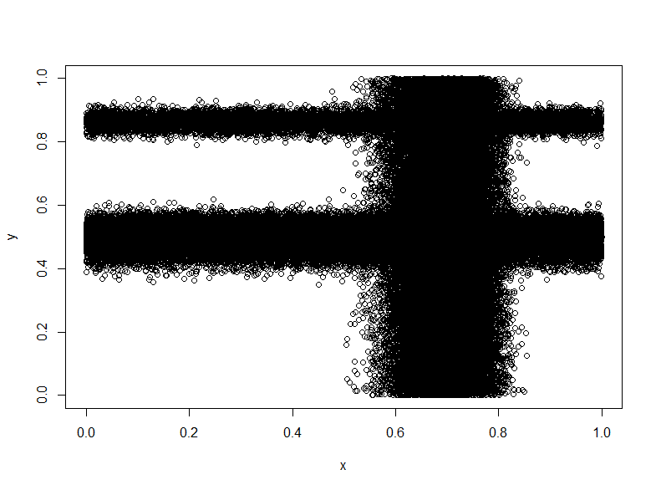
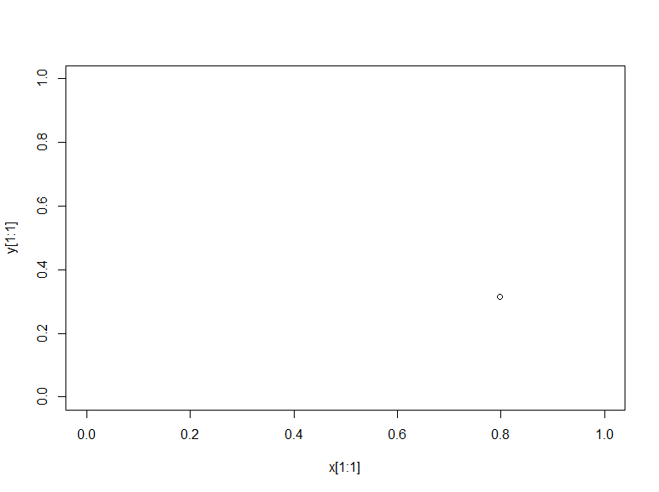
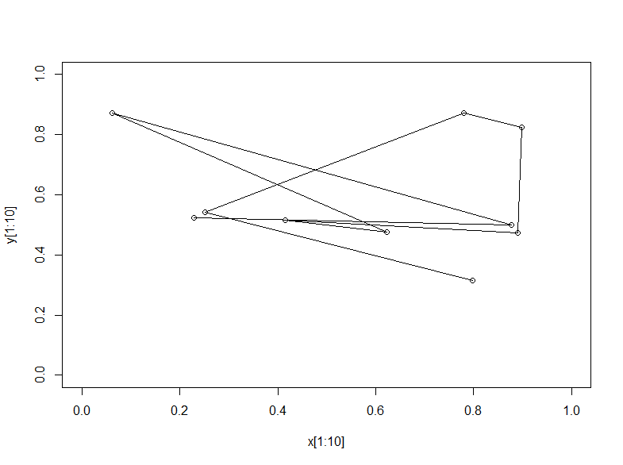
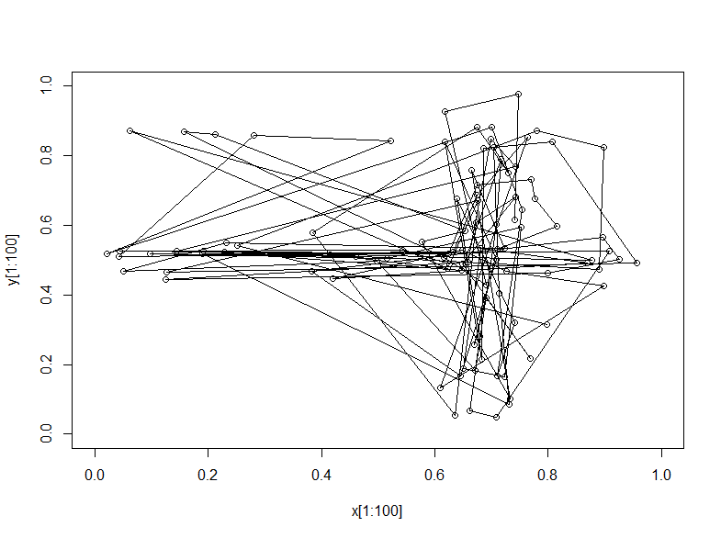
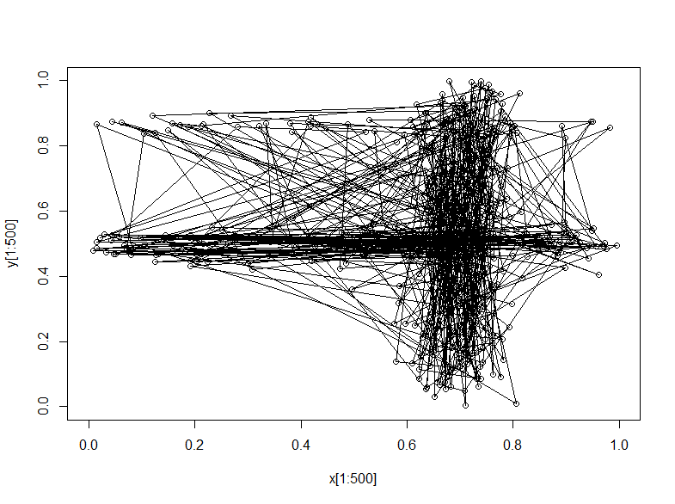
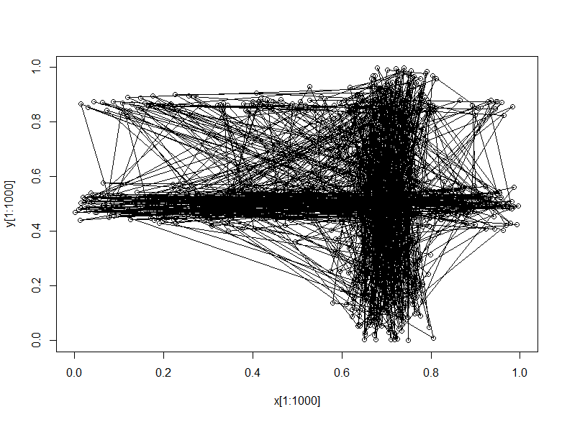
MCMC Process Simulation
The points in the beginning move rigorously and it may not in the high probability region, so we usually burn the points in the beginning. Here we burn 1,000 points since it appears that points are in high probability region when n=1,000.

Slide 78
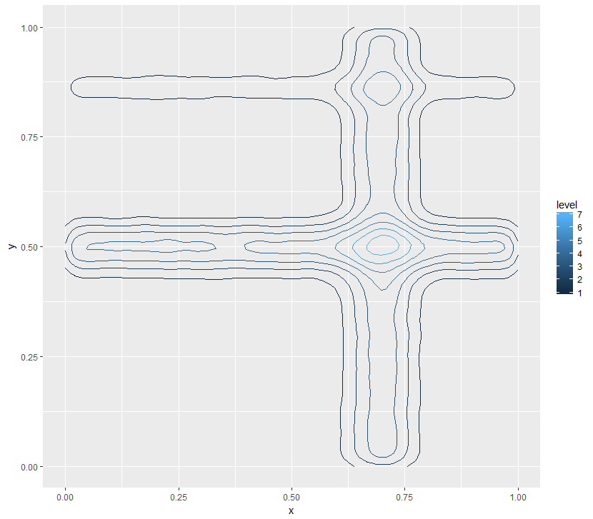
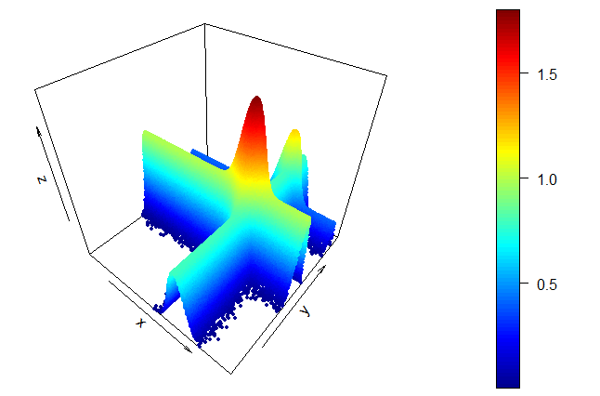
Plots of Sampled Function
In each chain, we sample 100,000 (1e5) pairs of points
We burn 1,000(1e3) points, therefore 99,000 points remain
Color of the 2d density plot become lighter, indicating that points are converge to the high value region

Slide 79
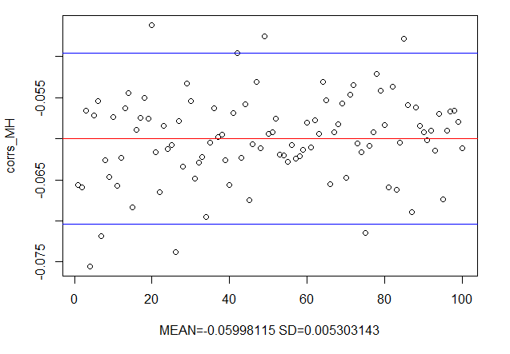
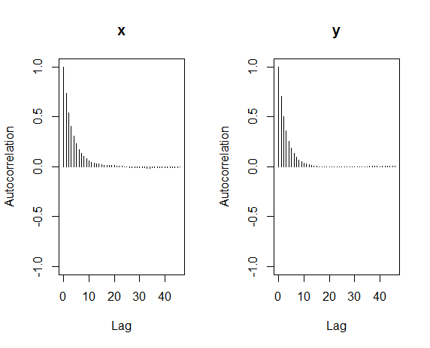
Result of Method1: Metropolis-Hastings Algorithm
Mean of correlation of 100 chain = -0.05990, SD = 0.005303, mean of acceptance rate =0.279
ACF Plot: ACF decay as time lag k increase, implies stationary, satisfy the condition of MCMC
Runtime for 1 chain: 53.08231 secs, Runtime for 100 chains: 88.9071 mins (5334.426 secs)

Slide 80
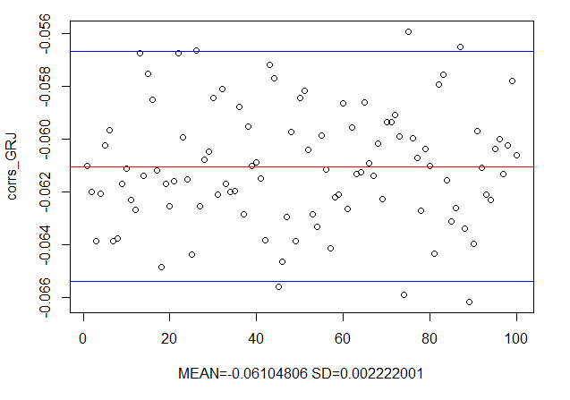
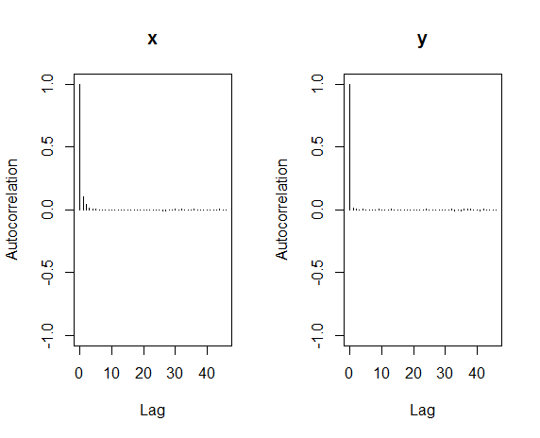
Result of Method2a: Gibbs Sampling with Rejection Method
Mean of correlation of 100 chain = -0.06104806, SD = 0.002222001
ACF Plot: ACF decay as time lag k increase, implies stationary, satisfy the condition of MCMC
Runtime for 1 chain: 30.66692 secs, Runtime for 100 chains: 50.4084 mins (3024.50373 secs)

Slide 81
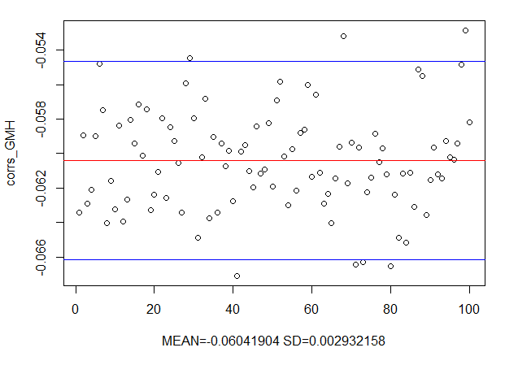
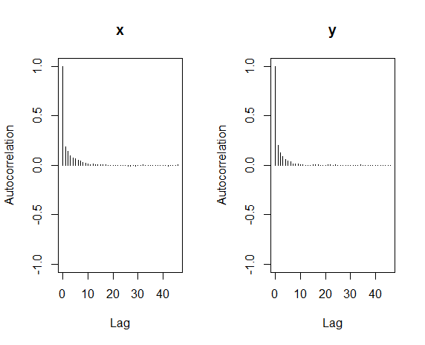
Result of Method2b: Gibbs Sampling with 1D Metropolis
Mean of correlation of 100 chain = -0.06041904, SD = 0.002932158
ACF Plot: ACF decay as time lag k increase, implies stationary, satisfy the condition of MCMC
Runtime for 1 chain: 2.72927 secs, Runtime for 100 chains: 4.556789 mins (273.40733 secs)

Slide 82
Comparison of Results
Method |  | Mean | SD | 95% C.I. | Running Time | Average Acceptance Rate
Metropolis-Hastings |  | -0.05990 | 0.005303 | (-0.07037, -0.04959) | 53.08231 secs | 0.279
Gibbs Sampling | With Rejection Method | -0.06105 | 0.002222 | (-0.06540, -0.05669) | 30.66692 secs | 1
 | With 1D Metropolis | -0.06042 | 0.002932 | (-0.06617, -0.05467) | 2.72927 secs
Gibbs Sampling is faster than Metropolis-Hasting Algorithm and the fastest one is the method combining above two.
Gibbs Sampling with Rejection Method yield the smallest confidence interval, its result concentrates more than the others, meaning that it gives more accurate answer.
Gibbs Sampling with 1D Metropolis is the most efficient one, which produced similar result as other with much less amount of time.

Slide 83
Q&a

Slide 84
Thank you!

